Slide 1
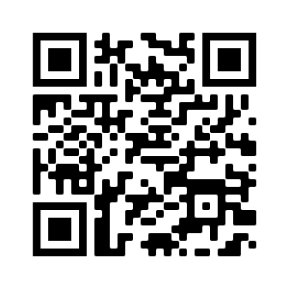
WELCOME!
For attendance credit, sign in with QR Code or link beside the QR Code
https://ky.readyop.com/fs/4osq/893976b5

Slide 2
MINUTES APPROVAL for
March 9, 2023 Meeting
REQUIRES VOTE
Discussion/Corrections? - Motion – Second
Zoom Voters: Put the following in the chat
Minutes
Agency/Your name
Yes/No or With Revisions

Slide 3
HEART Coalition EPI Report
Notes:
** All data presented is for situational awareness and is not to be shared with the general public.

Slide 4
Region 4 COVID-19 Numbers
County | Cases | Deaths
Allen | 8,628 | 127
Barren | 17,700 | 257
Butler | 4,845 | 61
Edmonson | 3,353 | 61
Hart | 6,978 | 111
Logan | 10,534 | 142
Metcalfe | 3,810 | 80
Monroe | 4,556 | 93
Simpson | 7,668 | 109
Warren | 56,152 | 438
Total: | 124,409 | 1,479
Notes:
This data is from KDPH COVID dashboard.
We saw the largest increase of case in the month of December.
**This table and numbers below are showing COVID deaths as they are being counted instead of when they occurred.
April to May
+815 case
+17 deaths
March to April
+984 case
+34 deaths
February to March
+1,720 cases
+8 deaths
January to February
+2,487 cases
+21 deaths
December to January:
+ 3,281 cases
+ 18 deaths
November to December:
+2,011 cases
+ 13 deaths

Slide 5
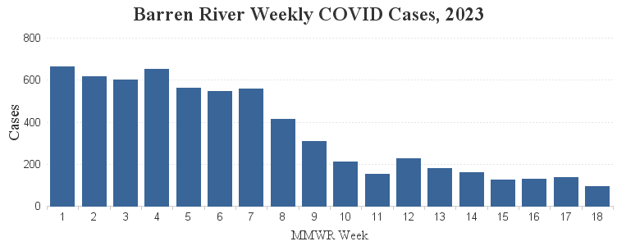
2023 Weekly COVID-19 Cases

Slide 6
Influenza
Notes:
**2020-2021 data may not be representative of true numbers of cases due to COVID-19.
MMWR week 51, flu types shifted to flu B.
There are been 12 flu related deaths in the Region.

Slide 7
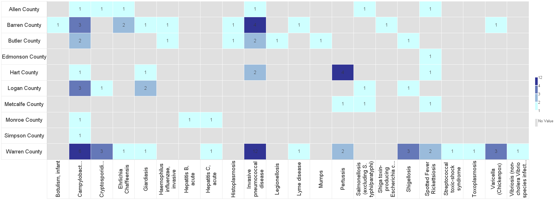
Barren River Reportable Disease 2023 Year to Date
Notes:
2022: 349 Reportable Diseases, investigations are still under review.
2023: 94 investigations confirmed as of 5/8/2023. This time last year, there were about 72 investigations.
**Numbers are not finalized and are subject to change.

Slide 8
Contact
Regional Epi: Kristen Eggles
Kristen.Eggles@ky.gov
Ext. 262
District Epi: India Martinez
India.Martinez@barrenriverhealth.org
Ext. 105

Slide 9
CDC Updates COVID-19 Universal Masking, Nursing Home Admission Testing Guidelines
KEY HIGHLIGHTS
CDC no longer links universal masking guidelines to its COVID-19 community transmission metric, which the agency will not calculate after the May 11 conclusion of the COVID-19 public health emergency (PHE).
The revised universal masking guidelines recommend that facilities:
Use a risk-based assessment, stakeholder input and local metrics to determine how and when to implement universal masking;
Implement universal masking under specific circumstances such as during COVID-19 outbreaks in specific work units or areas or in accordance with state/local public health authority recommendations; and
Continue to allow individuals to wear masks or respirators based on personal preference.
CDC no longer recommends testing all nursing home admissions for COVID-19; testing is now at the discretion of the facility.

Slide 10
COMMITTEE UPDATES
Long Term Care
Communications
Training & Exercise
Use this QR Code to sign in. Be sure to list ALL agencies you represent!
https://ky.readyop.com/fs/4osq/893976b5

Slide 11
Pediatric Surge Exercise April 27, 2023
Strengths:
Good collaboration in the region
Good communication withing the group
What facilities in region do and the pediatric resources available
Knowledge and experience
Group cooperation is highly effective
Areas for Improvement:
Better involvement/information from school systems/law enforcement about their plans and operations
Patient tracking/Family reunification - Need more information and more practice toward goal of universally accepting ReadyOp for patient tracking/family reunification
Need to clarify role of Red Cross
Public Information

Slide 12
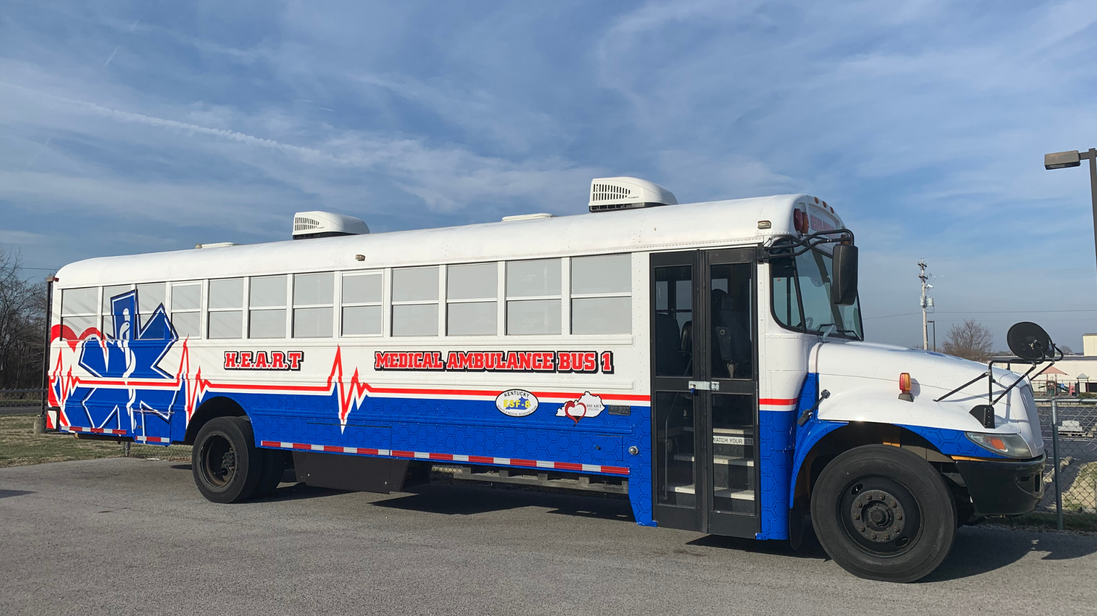
Executive Breakfast
25 Attendees
5 Elected Officials from 4 different counties
9 of 10 hospitals represented
Emergency Management
Emergency Medical Services
American Red Cross
Long Term Care
Attendees had opportunity to go through the ambubus

Slide 13
In-Person Training
MGT-345 (16hr) Disaster Management for Electric Power systems – June 21-22, 2023 Register here
MGT-343 (16hr) Disaster Management for Water and Wastewater Utilities – Sept. 13-14, 2023 Register here
MGT-341 (16hr) Disaster Preparedness for Healthcare Organizations within the Community Infrastructure – December 13-14, 2023 at WKU Center For Research & Development, Room 129 Register here
G191 ICS/EOC Interface Workshop – June 26, 2023 – Boone County EMA, 3000 Conrad Lane, Burlington, KY 41005 Register here
MGT-403 (8hr) Underserved Populations Preparedness Planning for Rural Responders and Volunteers – September 6, 2023 - 830 Phillips Lane, Louisville, KY 40209 Register here
Use this QR Code to sign in. Be sure to list ALL agencies you represent!
https://ky.readyop.com/fs/4osq/893976b5

Slide 14
In Person Training
What: MGT 348, Medical Preparedness & Response for Bombing Incidents Course
When: August 30-31, 2023
Where: WKU Center for Research & Development
Who: The following are recommended participants:
Emergency Medical Services (EMS)
Law Enforcement (local, county
Fire Services
Communications (Dispatchers)
Specialty Teams Members (SWAT, Tactical Medics, Bomb Team, Haz Mat)
Hospital Personnel
Medical Professionals
Emergency Management
City, County State, Federal Stakeholders
Community Emergency Response Teams (CERT)
Private Industry
The HEART Healthcare Coalition will provide coffee, soft drinks, water all day and lunch both days.

Slide 15
What: MGT 312 Senior Officials Workshop for All-Hazards Preparedness
When: October 24, 2023
Where: BRADD
Who: Elected and appointed senior officials from local jurisdiction, but may also include executives from other community entities, both public and private that are likely to be involved in a disaster response, including
Directors of local response agencies
Chiefs of departments: fire, law, EMS, HazMat, public works, water, public health, health care, EMA, governmental administrative disciplines/services
Public Information Officers
Resident federal agency reps (FBI, BATF, Secret Service)
CEO’s of hospitals, college and university representatives, school district superintendents
Airport managers
Stadium and sports facility managers and directors of security
The HEART Healthcare Coalition will provide coffee, soft drinks, water and lunch.

Slide 16
What: PER 211 – Medical Management of Chemical, Biological, Radiological, Nuclear, and Explosive (CBRNE) Events
When: March 19-20 , 2024
Where: WKU Center for Research & Development,
Room 120 & 130
Who: The following are recommended participants:
Fire Services
Law Enforcement
Emergency Medical Services (EMS)
Hospital Personnel, Physicians, and Nurses
Public Health Services
Emergency Management Organizations
City, County, State, Federal Medical
Private Industry
Community Emergency Response Teams (CERT)
Dispatchers
The HEART Healthcare Coalition will provide coffee, soft drinks, water and lunch.

Slide 17
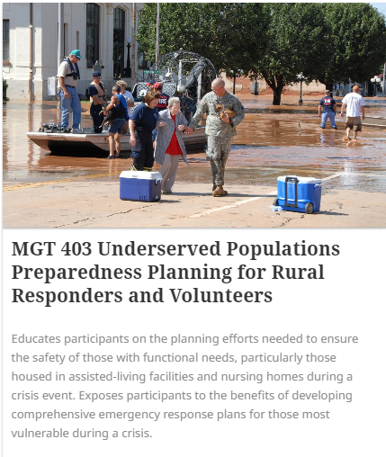
What: MGT 403
When: September 6, 2023 8:00 am – 5:00 pm EST
Where: 830 Phillips Lane, Louisville, KY 40209
Prerequisites:
IS-0100.b-Introduction to Incident Command System
IS-0368-Including people with Disabilities and Others with Access and Functional Needs in Disaster Operations
IS-0200.b-ICS for Single Resources and Initial Action Incidents or IS-0200 HCa-Applying ICS to Healthcare Organizations

Slide 18
Empower Data Updates Janarae Conway

Slide 19
MACH 5 - 5 Minutes to Preparedness
In the last scenario, you arrived at the EOC and began to set it up. The generator is finally on, and with the lights on, you can see that there are many cracks in the walls, some overhead lights fell, and many items are scattered around the room.
What can be done now, before an earthquake strikes, to ensure that the EOC (or your regular work space) is a safe work place in a disaster?
Keep responses to 25 to 30 seconds.

Slide 20
The drill was sent by TEXT and EMAIL. This exercise served as a required redundant communications drill and the RSVP for this coalition meeting.
Two components were responding YES (attending in person) or NO (not attending) or ZOOM (attending via Zoom) through BOTH text AND email.
Response from All Partners:
70.59% completed at least one portion of the drill
Response from Core* Partners:
90.6% completed at least one portion of the drill
87.5% completed both portions of the drill
May 8 Redundant Communication Drill Results
Use this QR Code to sign in. Be sure to list ALL agencies you represent!
*Core Partners are defined by the Assistant Secretary for Preparedness and Response as Hospitals, EMS, EMA, and Public Health

Slide 21
Miscellaneous/Questions
Unmet Needs?
Contacts for equipment requests, emergent needs through May 13 – May 21:
Gail Timperio, Healthcare Preparedness Coordinator, CynthiaG.Timperio@ky.gov or 502-905-9963
Ken Kik, Healthcare Preparedness Program Manager, Kenneth.Kik@ky.gov
Anita Adams, Regional Preparedness Coordinator, Anita.Adams@ky.gov or 502-229-9256 (available after 5/18)
Use this QR Code to sign in. Be sure to list ALL agencies you represent!

Slide 22
Meeting Changes!
September 14 meeting is Zoom ONLY
December 7 Meeting

Slide 23
Next Meeting
Thursday, June 8, 2023
11:30am Lunch available/Networking
12:00pm Meeting time
Use this QR Code to sign in. Be sure to list ALL agencies you represent!

