Slide 1
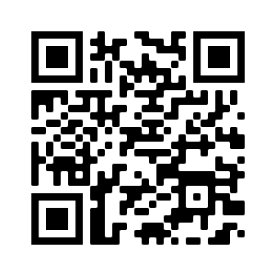
PLEASE SIGN IN WITH QR CODE

Slide 2
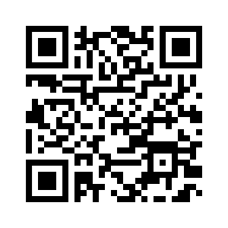
WELCOME!
MINUTES APPROVAL for
January 12, 2023 Meeting
REQUIRES VOTE
Discussion/Corrections? - Motion – Second
Vote – You MUST list the agency you are voting for! You may represent more than one agency for attendance, but ONLY vote as a representative for ONE agency.
Use this QR Code to vote. Be sure to vote your primary agency ONLY!

Slide 3
HEART Coalition EPI Report
Notes:
** All data presented is for situational awareness and is not to be shared with the general public.

Slide 4
Region 4 COVID-19 Numbers
County | Cases | Deaths
Allen | 8,455 | 125
Barren | 17,089 | 238
Butler | 4,705 | 57
Edmonson | 3,259 | 57
Hart | 6,829 | 110
Logan | 10,229 | 138
Metcalfe | 3,683 | 77
Monroe | 4,478 | 89
Simpson | 7,434 | 104
Warren | 54,543 | 425
Total: | 120,704 | 1,420
Notes:
This data is from KDPH COVID dashboard.
January to February
+2,487 cases
+21 deaths
December to January:
+ 3,281 cases
+ 18 deaths
November to December:
+2,011 cases
+ 13 deaths

Slide 5
2023 Weekly COVID-19 Cases

Slide 6
January 2022 vs. 2023

Slide 7
Influenza
Notes:
**2020-2021 data may not be representative of true numbers of cases due to COVID-19.
MMWR week 51, flu types shifted to flu B. Although MMWR week 5 only had 8 cases, 6 of them were flu B.
There are been 11 flu related deaths in the Region.

Slide 8
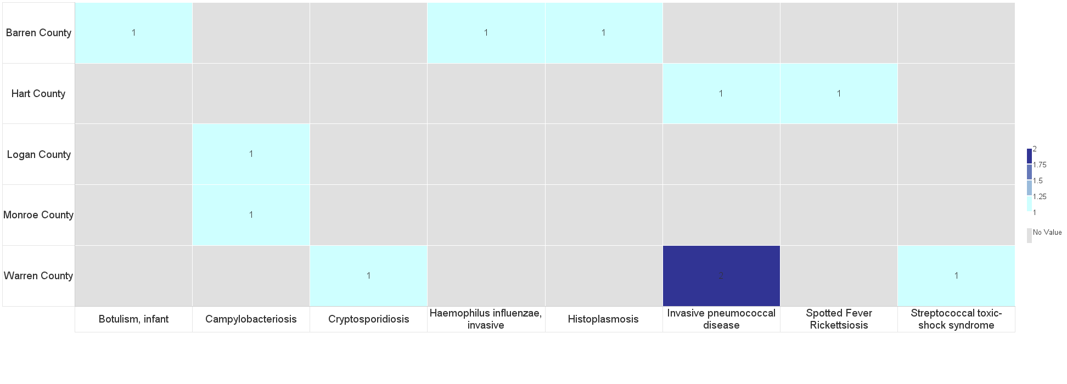
Barren River Reportable Disease 2023 Year to Date
Notes:
2022: 344 Reportable Diseases, investigations are still under review.
2023: 11 Reportable Diseases
**Numbers are not finalized and are subject to change.

Slide 9
Contact
Regional Epi: Kristen Eggles
Kristen.Eggles@ky.gov
Ext. 262
District Epi: India Martinez
India.Martinez@barrenriverhealth.org
Ext. 105

Slide 10
COMMITTEE UPDATES
Long Term Care – Greg Manley
Communications – Robert Doughty
Budget and Inventory – Yvette Coleman
Training & Exercise
Use this QR Code to sign in. Be sure to list ALL agencies you represent!

Slide 11
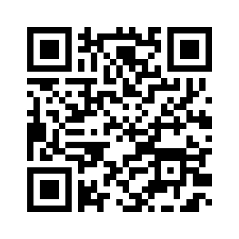
Budget FY22-23
#1. Office Supplies – Emergency purchase of printer ink and vis-à-vis wet erase markers (unavailable through KDPH)
$75
#2. Tennessee All Hazards Emergency Preparedness Summit – March 15-16, 2023 Union City, TN
(3 each Scholarships: Est.$2,000)
#3 Planning Budget for FY23-24 BP5

Slide 12
Over 50 participants including industry and churches
Feedback:
Good information and overview of things to consider when developing plan
This generated discussions for us to make some positive changes at our office
Increased awareness
Working with other agencies to exercise our plan

Slide 13
Teex Course: Understanding targeted cyber attacks Key Points
Common targeted cyber attack and advanced persistent threat (APT) targets
Private Sector – Individuals
Public Sector – All levels of government – EMS, education institutions
Critical Infrastructure – Health Care
Phases of Target Cyber Attack
Reconnaissance
Initial Breach
Lateral Movement
Accomplish Attack Objectives
Does your organization have “acceptable use” policies for employees?
When someone leaves, do you have an off-boarding process to disable their accounts?
Face-to-face Cyber Hygiene classes to address:
Passwords, Phishing, Removable Media, Tailgating, WiFi Spoofing
Does your agency have any remote access programs that are not being used?
Do you have a process for disabling access after an intern leaves your facility?
Do you have an Incident Response Team? A recovery plan?
If hit by ransomware, how will you know the data hasn’t been changed?

Slide 14
Targeted Violence & Terrorism Prevention Briefing Wednesday, February 15 and March 8, 2023 8:00am-10:00am Central
KOHS TVTP Training Registration https://app.smartsheet.com/b/form/bc8f2070ec944c27abca4fa4a9969484
The Kentucky Office of Homeland Security (KOHS) is proud to present the DHS Center for Prevention Programs and Partnerships (CP3) Targeted Violence and Terrorism Prevention Training. This training is intended for Kentucky's state, local, tribal, and territorial (SLTT) entities and will focus on prevention of violence though the identification of the early warning signs of targeted violence and/or terrorist attacks. This training will be delivered virtually and is approximately two hours long. There are several training dates available and more dates will be announced in the future. Questions or concerns may be addressed to: Jennifer Taylor CP3/TVTP Program Coordinator Kentucky Office of Homeland Security Kentucky Intelligence Fusion Center Jennifer.Taylor@KY.gov

Slide 15
MGT-439 Pediatric Disaster Response and Emergency Preparedness
March 21-22, 2023
WKU Center for Research & Development
Room 129
Recommended participants:
Community and Hospital based Emergency Managers
EMS Personnel
Hospital Administration and Emergency Room Personnel
Public Safety/Public Health Personnel
School Administrators
MRC Personnel
Private Sector
Law Enforcement
Disaster Response/Relief personnel
https://my.teex.org/TeexPortal/Default.aspx?MO=mCourseCatalog&D=FP&C=MGT439&S=461

Slide 16
In-Person Training at BRADD
Infrastructure Disaster Management Certificate Program
MGT-317 (16hr) Disaster Management for Public Services – March 15-16, 2023 Register here
MGT-345 (16hr) Disaster Management for Electric Power systems – June 21-22, 2023 Register here
MGT-343 (16hr) Disaster Management for Water and Wastewater Utilities – Sept. 13-14, 2023 Register here
MGT-341 (16hr) Disaster Preparedness for Healthcare Organizations within the Community Infrastructure – December 13-14, 2023 Register here
Use this QR Code to sign in. Be sure to list ALL agencies you represent!

Slide 17
The drill was sent by TEXT and EMAIL. This exercise served as a required redundant communications drill and the RSVP for this coalition meeting.
Two components were responding YES (attending in person) or NO (not attending) or ZOOM (attending via Zoom) through BOTH text AND email.
Response from All Partners:
72.1% completed at least one portion of the drill
Response from Core* Partners:
96.8% completed at least one portion of the drill
90.1% completed both portions of the drill
February 2 Redundant Communication Drill Results
Use this QR Code to sign in. Be sure to list ALL agencies you represent!
*Core Partners are defined by the Assistant Secretary for Preparedness and Response as Hospitals, EMS, EMA, and Public Health

Slide 18
HEART Officers
Chairperson
Vice-Chairperson
Clinical Advisor
Member-at-Large

Slide 19
MACH 5 - 5 Minutes to Preparedness
Building on last month’s scenario, you have arrived to the City’s EOC/DOC and you are setting up the EOC/DOC according to the manual, but you are in the dark. Apparently the generator has not kicked in?
How will you ensure the EOC’s?DOC’s back-up generator will supply the necessary electricity to run the facility?
Or if you don’t have a generator, how will you operate the EOC/DOC without electricity?
Keep responses to 25 to 30 seconds.

Slide 20
In addition to the ideas mentioned, you may also want to consider the following:
Posted Generator Instructions – Consider including generator instructions and troubleshooting issues in your EOC/DOC Operations manual and on the generator itself.
Full-Load Generator Tests – Many jurisdictions do have back-up generators and perform regular generator tests. These tests usually occur on off hours so as not to impact operations. The jurisdiction should perform a test during normal working hours with a full load to anticipate any problems that may arise.
Generator Training – Most generators in the jurisdiction are services and maintained by facilities/maintenance staff. If these staff members are not around, you may not have anyone around that can help you with generator issues. It is highly recommended that the jurisdiction have a cadre of staff. Include other staff in Generator Training sessions to broaden the pool of people having an understanding of the generator and how it works.

Slide 21
Miscellaneous/Questions
SAVE THE DATE!
Executive Breakfast – May 3, 2023 at BRADD Conference Room
Did you sign in? Please sign in via ReadyOp to be sure the agency/agencies you represent are included in the attendance.
Use this QR Code to sign in. Be sure to list ALL agencies you represent!

Slide 22
Next Meeting
Thursday, March 9, 2023
11:30am Lunch available/Networking
12:00pm Meeting time
Use this QR Code to sign in. Be sure to list ALL agencies you represent!

